Slide 1
CAPSTONE PROJECT
TRAVEL DESTINATION RECOMMENDATION SYSTEM
Alexander Derek Veale

Slide 2
Background, Problem Statement & Target Audience
The tourism industry is a massive market and growing steadily as internation travel becomes easier and more affordable(ignoring the effects of the pandemic)
Travel companies spend lots of money trying to attract customers and sell the travel deals and packages
Problem statement: create a model that clusters popular travel destinations and makes recommendations based on previous travel experiences
This would increase customer satisfaction by making better travel recommendations
This would allow better targeting when advertising particular destinations to particular customers

Slide 3
Data Collection and Cleaning
Downloaded a list of the Top 100 Cities travelled to in 2019 from ‘Euromonitor’, converted the file from pdf to html format and the scraped the contents in python
Got the coordinates of each city using the ‘geopy’ library in the Skills Network Labs environment, saved the data frame as a csv file and them imported them into the project notebook
Retrieved a list of the venues within a 7.5km radius of the city’s coordinates using the Foursquare API as well as the requests and json libraries
Removed venues that were of no concern to tourists/found in all destinations/were of less importance but would have a high frequency of occurrence
Merged similar venue categories relating to nightlife and sports venues into single categories respectively
503 unique venue categories reduced to 325 and 9191 venues reduced to 5470

Slide 4
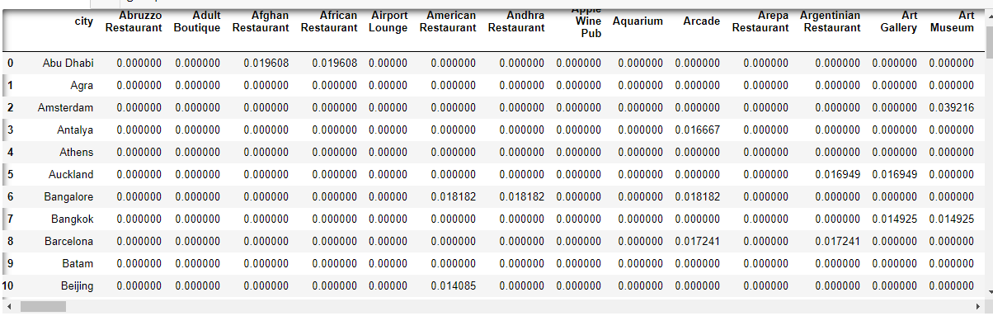
Feature Selection
Used the data frame of venues and categories to create a frequency table representing the proportion of each venue category found in each city using the ‘get_dummies’ method, a portion of which can be seen below

Slide 5
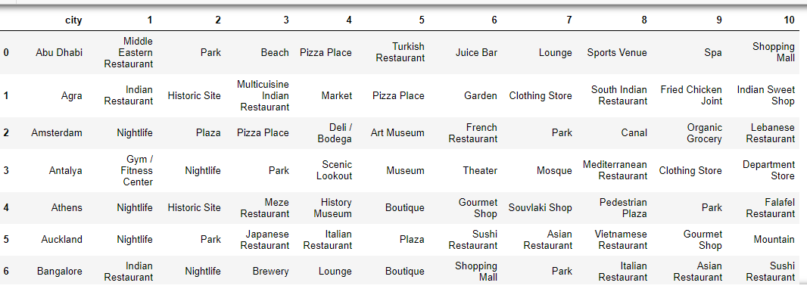
Exploratory Data Analysis
Created a data frame containing the top 10 most frequently occurring venue categories for each city, a snippet of which can be seen above

Slide 6
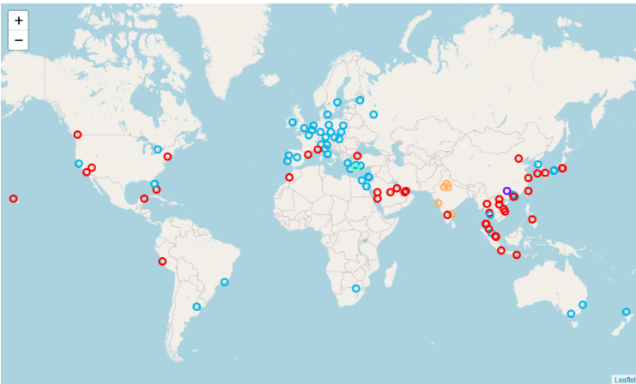
Data Modeling - KMeans
Used the frequency table to train a Kmeans model with 5 clusters – 1 cluster for each of the 5 broad holiday types
Visualized the resulting clusters using folium and different coloured markers for each cluster

Slide 7
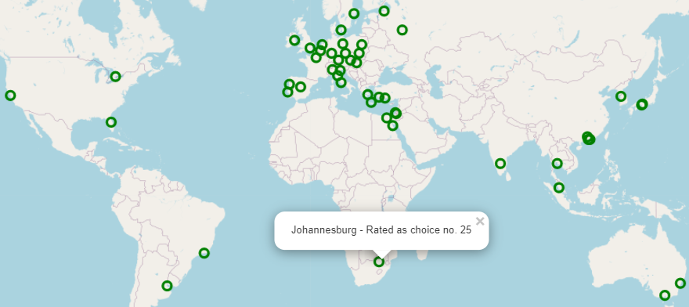
Results
A client could pass an unknown city to the program and get back a list of recommended travel destinations bases on the predicted cluster of the unknown city, the resulting recommendations were visualized and ranked as follows

Slide 8
Recommendations
Problem – dataset only includes large cities with international airports
Thus more remote tourism hotspots were neglected – leading to ‘nature/wildlife’ and ‘adventure/sporting’ holiday types to be severely under represented and therefore were not captured by the model
Increase the size of the initial dataset, making sure to include more remote tourism hotspots, especially in Africa and South America
How to properly include restaurants in the model can become very tricky
Refine recommendations further using desired characteristics rather than destination popularity

Slide 9
Conclusion
The model that was built can be used to make good travel recommendations based on a client’s past travel experience
However, there is definitely room for improvement
That concludes my Capstone Project!

